Slide 1
STACKS
By
Prof. Dhananjay S. Deshpande
SICSR, Pune - 16.

Slide 2
Linear Lists
A Linear List is a list in which each element has a unique successor.
In a restricted linear list, addition and deletion of data are restricted to the ends of the list.
In a general linear list, addition and deletion of data are allowed everywhere.

Slide 3
Stack
A stack is a linear list in which additions and deletions of data are restricted to one end, called the top.
If we insert a data series into a stack and then remove it, the order of data is reversed.
This property is known as the last in – first out.

Slide 4
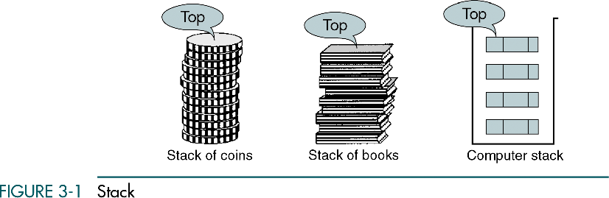

Slide 5
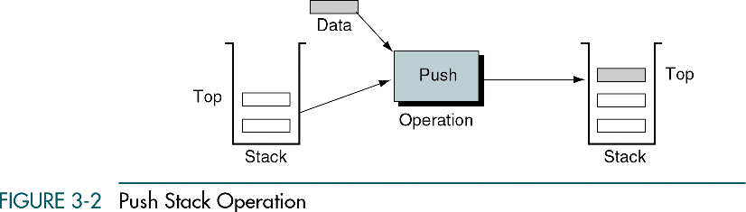

Slide 6
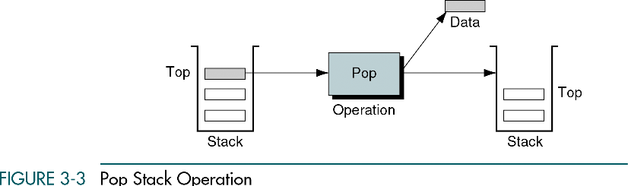

Slide 7
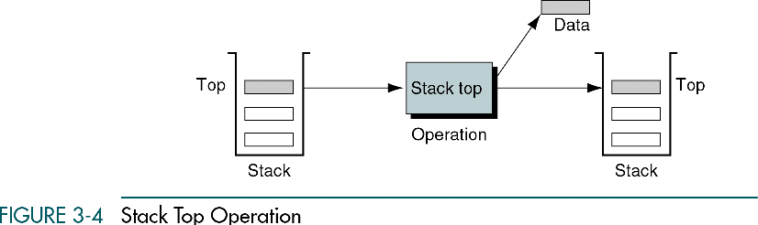

Slide 8
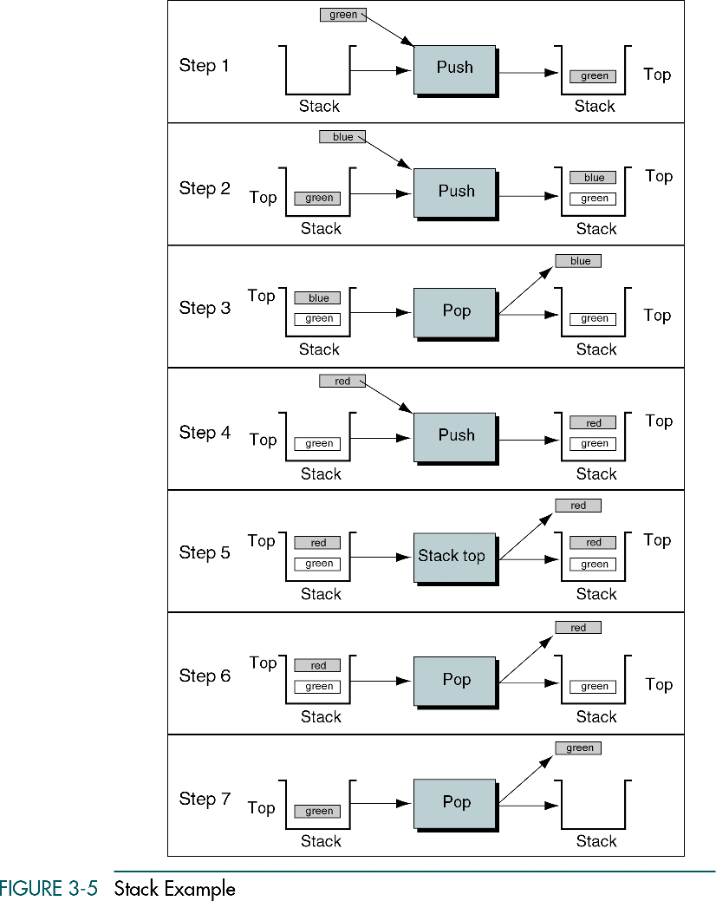

Slide 9
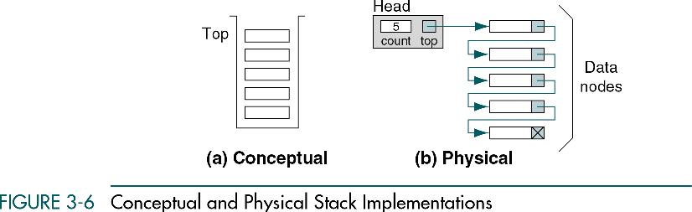

Slide 10
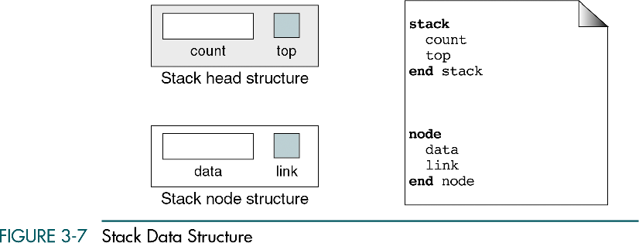

Slide 11
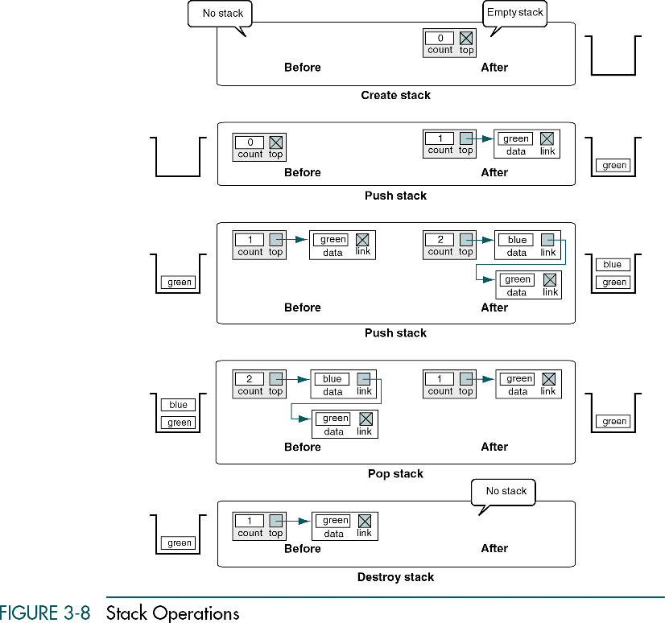

Slide 12
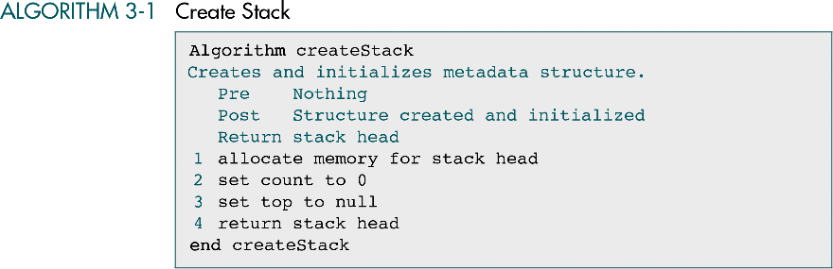

Slide 13
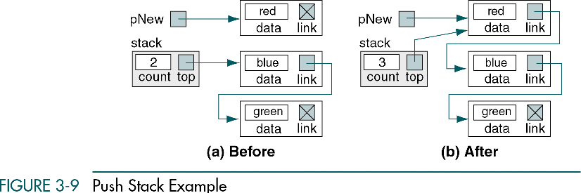

Slide 14
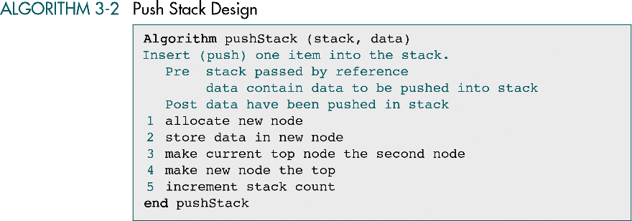

Slide 15
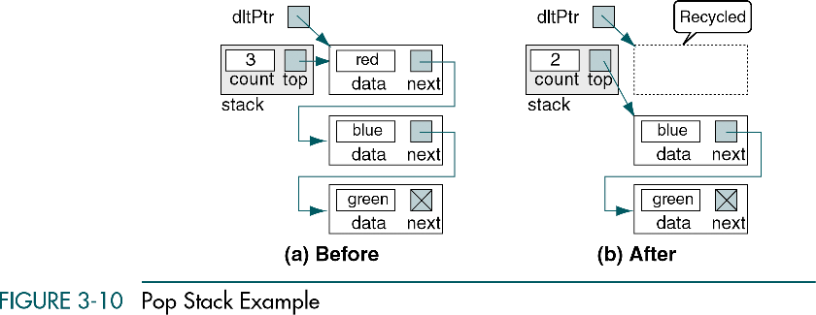

Slide 16
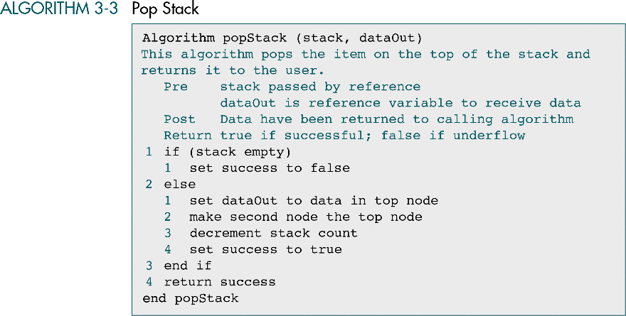

Slide 17
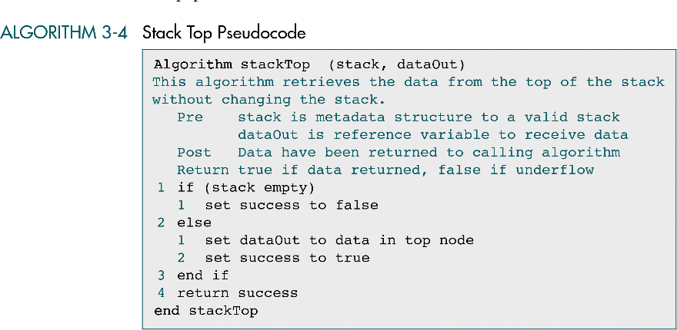

Slide 18
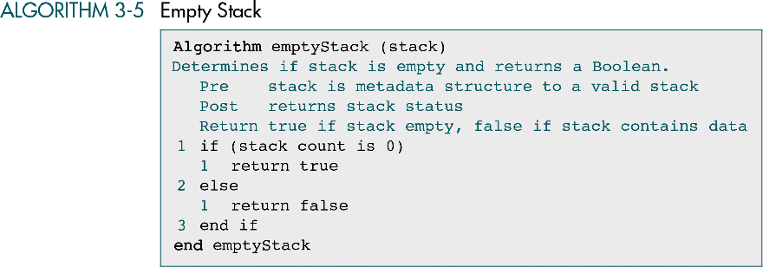

Slide 19
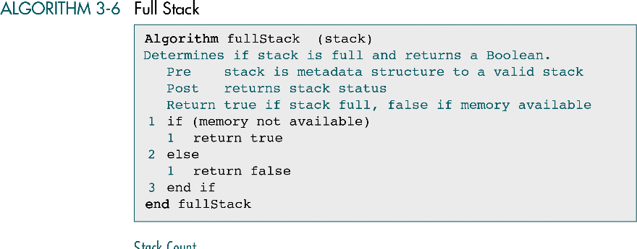

Slide 20
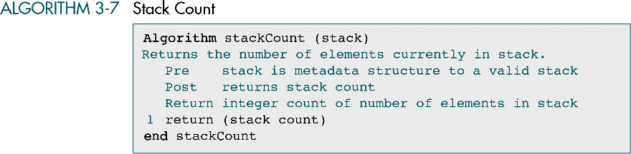

Slide 21
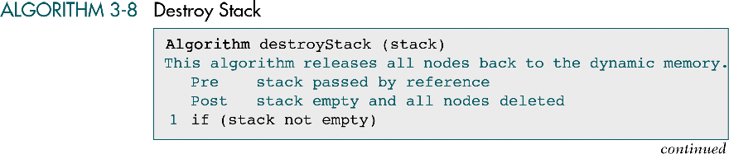

Slide 22
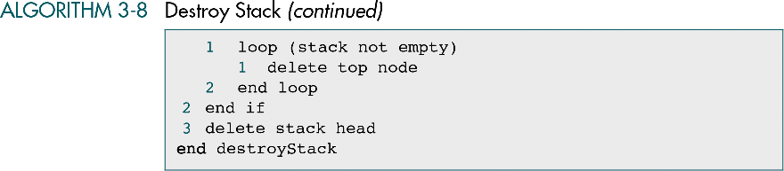

Slide 23
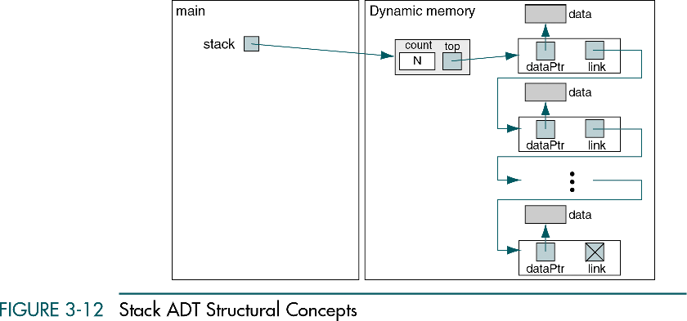

Slide 24
Thank You!!!

